Slide 1

NEXUS
Copyright © AESIR 2012

Slide 2
NEXUS
Copyright © AESIR 2012

Slide 3
NEXUS
Copyright © AESIR 2012

Slide 4
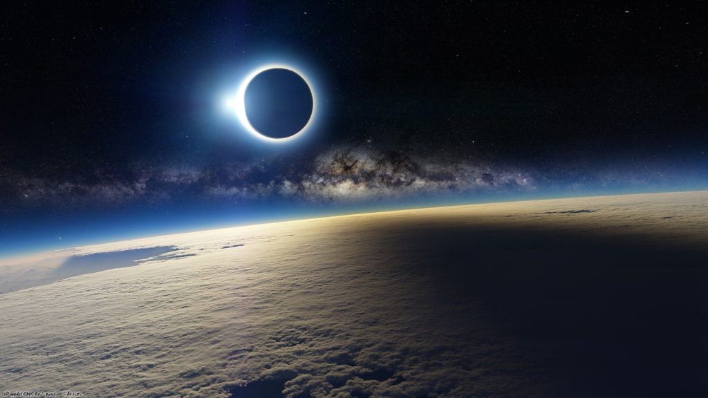
NEXUS
Copyright © AESIR 2012
NEXUS
Copyright © ELFPRO 2015

Slide 5
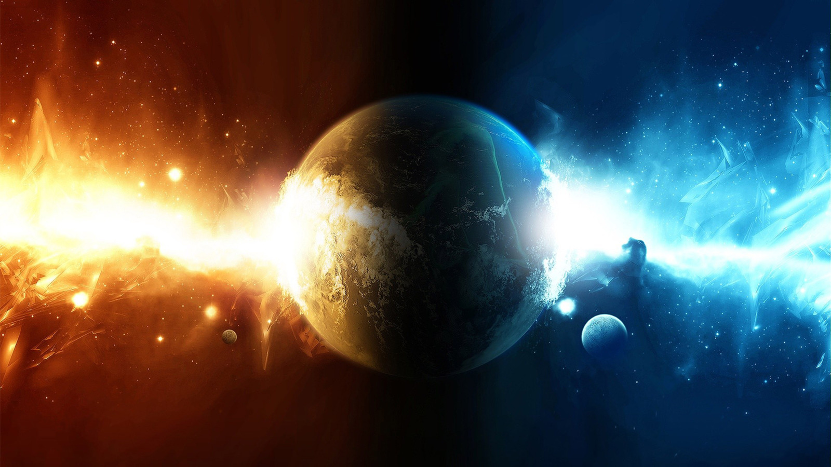
NEXUS
Copyright © ELFPRO 2015

Slide 6
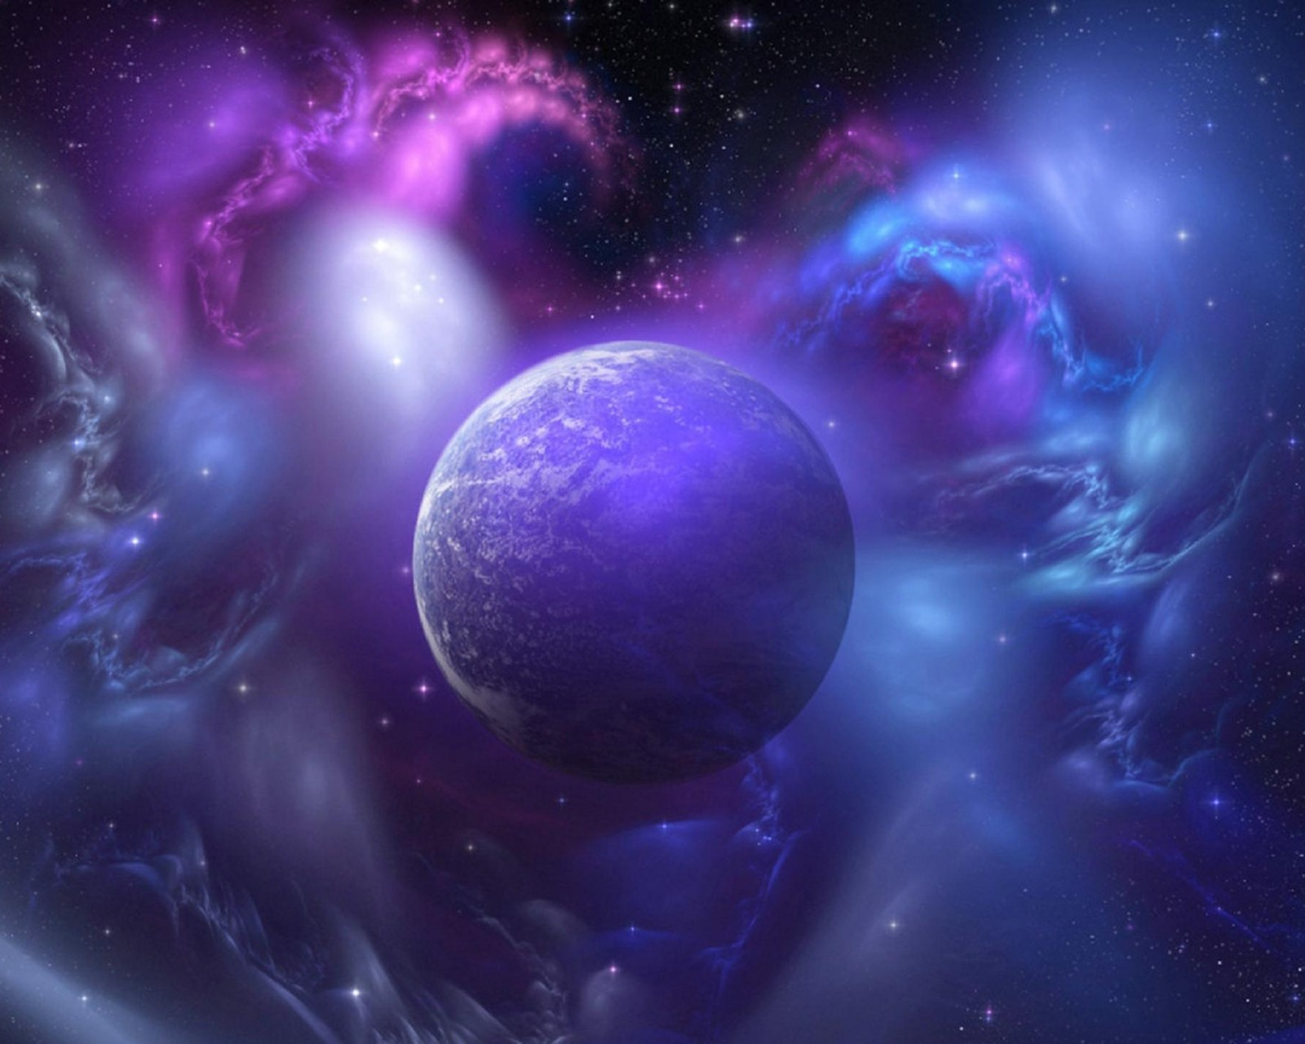
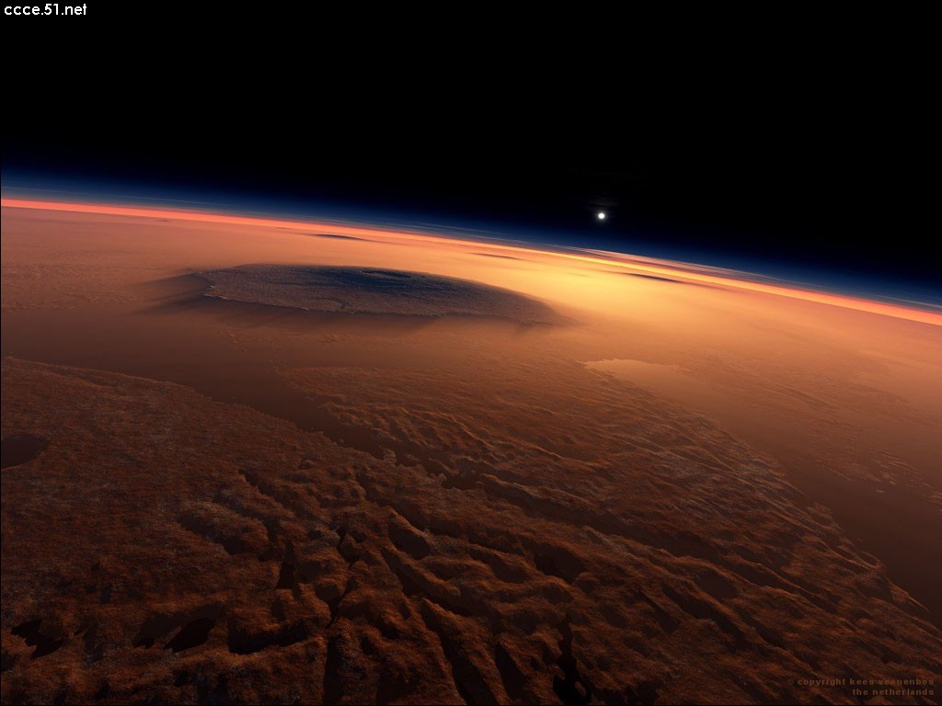
NEXUS
Copyright © ELFPRO 2015

Slide 7
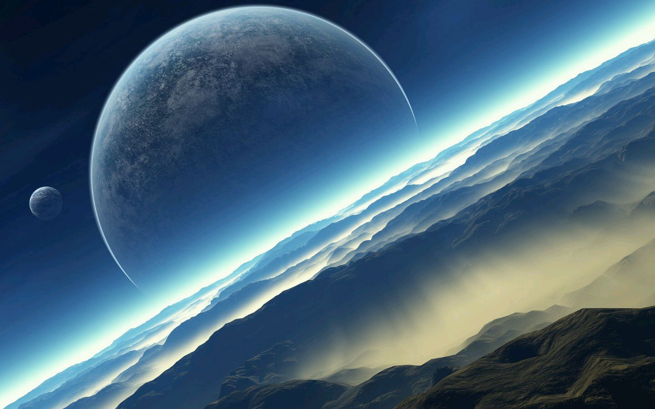
NEXUS1
Copyright © ELFPRO 2015

Slide 8
NEXUS2
Copyright © ELFPRO 2015

Slide 9
NEXUS3
Copyright © ELFPRO 2015

Slide 10
NEXUS4
Copyright © ELFPRO 2015

Slide 11
NEXUS5
Copyright © ELFPRO 2015

Slide 12
NEXUS6
Copyright © ELFPRO 2015

Slide 13
NEXUS7
Copyright © ELFPRO 2015

Slide 14
NEXUS8
Copyright © ELFPRO 2015

Slide 15
NEXUS9
Copyright © ELFPRO 2015

Slide 16
NEXUS10
Copyright © ELFPRO 2015

Slide 17
NEXUS11
Copyright © ELFPRO 2015

Slide 18
NEXUS12
Copyright © ELFPRO 2015

Slide 19
NEXUS13
Copyright © ELFPRO 2015

Slide 20
NEXUS14
Copyright © ELFPRO 2015

Slide 21
NEXUS15
Copyright © ELFPRO 2015

Slide 22
NEXUS16
Copyright © ELFPRO 2015

Slide 23
NEXUS17
Copyright © ELFPRO 2015

Slide 24
NEXUS18
Copyright © ELFPRO 2015

Slide 25
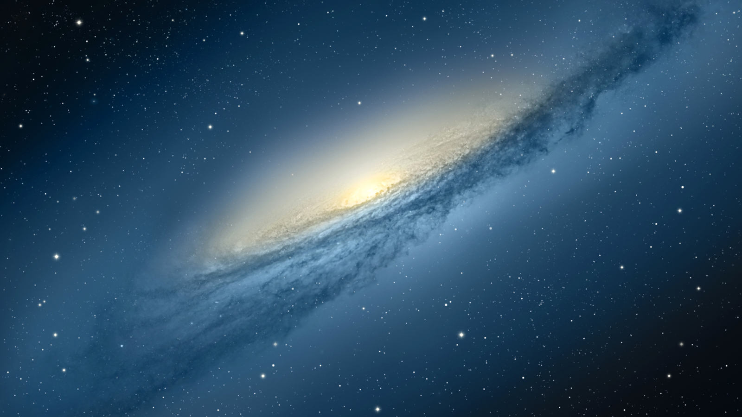
NEXUS
Copyright © ELFPRO 2015

Slide 26
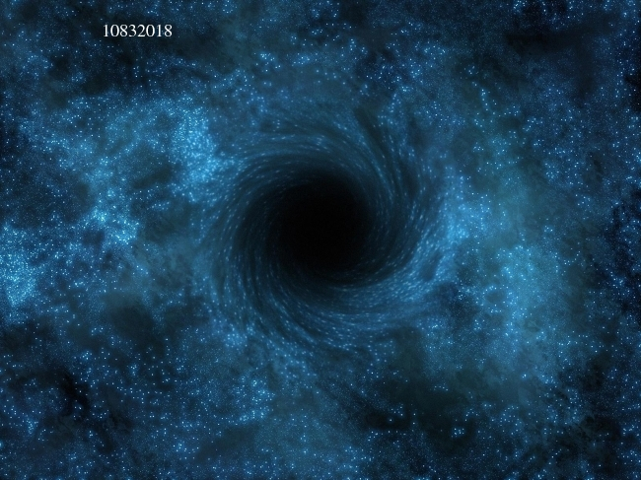
NEXUS
Copyright © ELFPRO 2015

